Slide 1


Slide 2


Slide 3


Slide 4
Accountability

Slide 6
Authenticity

Slide 7


Slide 8
Curiosity

Slide 9



Slide 10

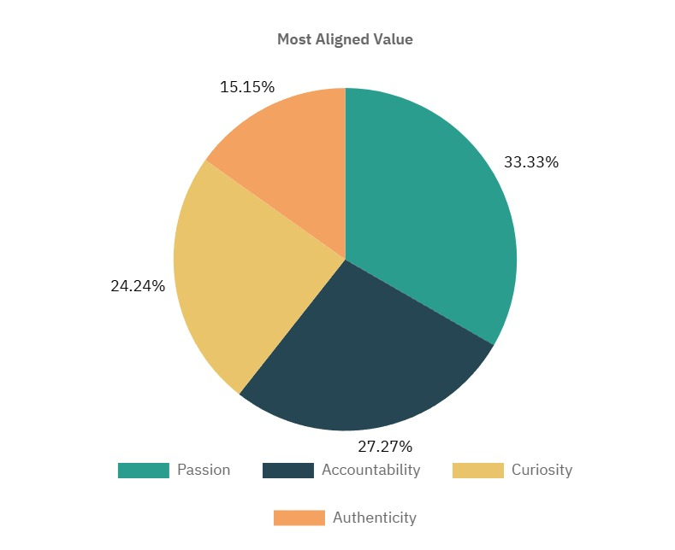

Slide 11

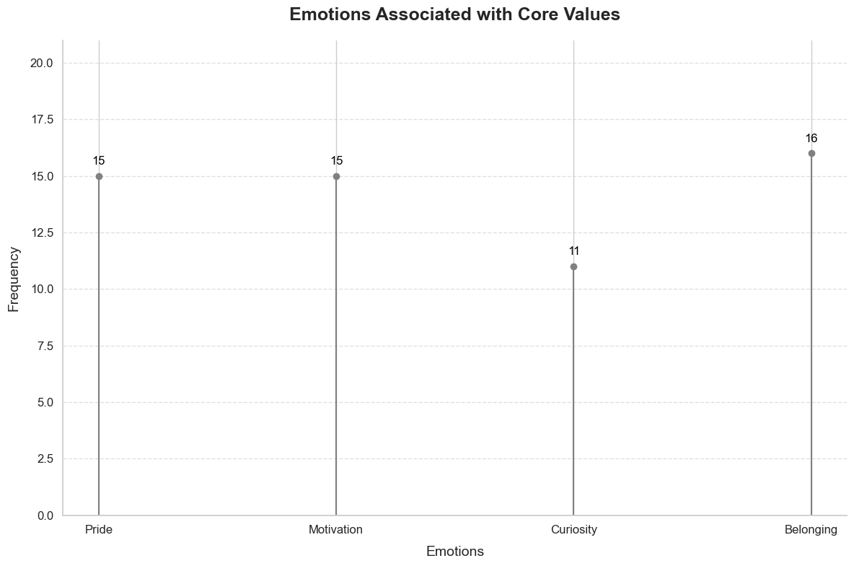

Slide 12

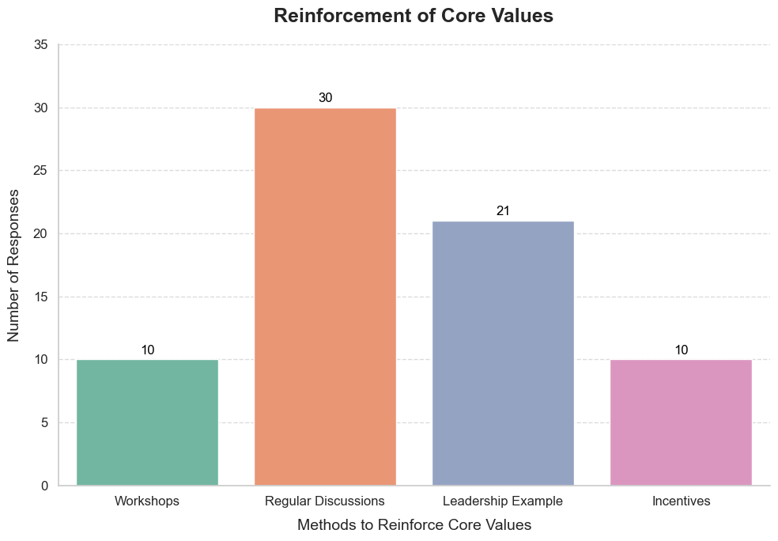

Slide 13

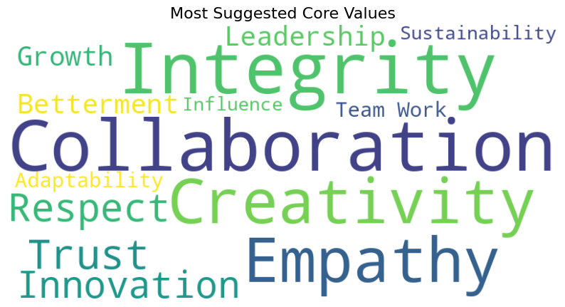

Slide 15
Insights from our Interviews
Diverse Perspectives
Personal Stories

Slide 16
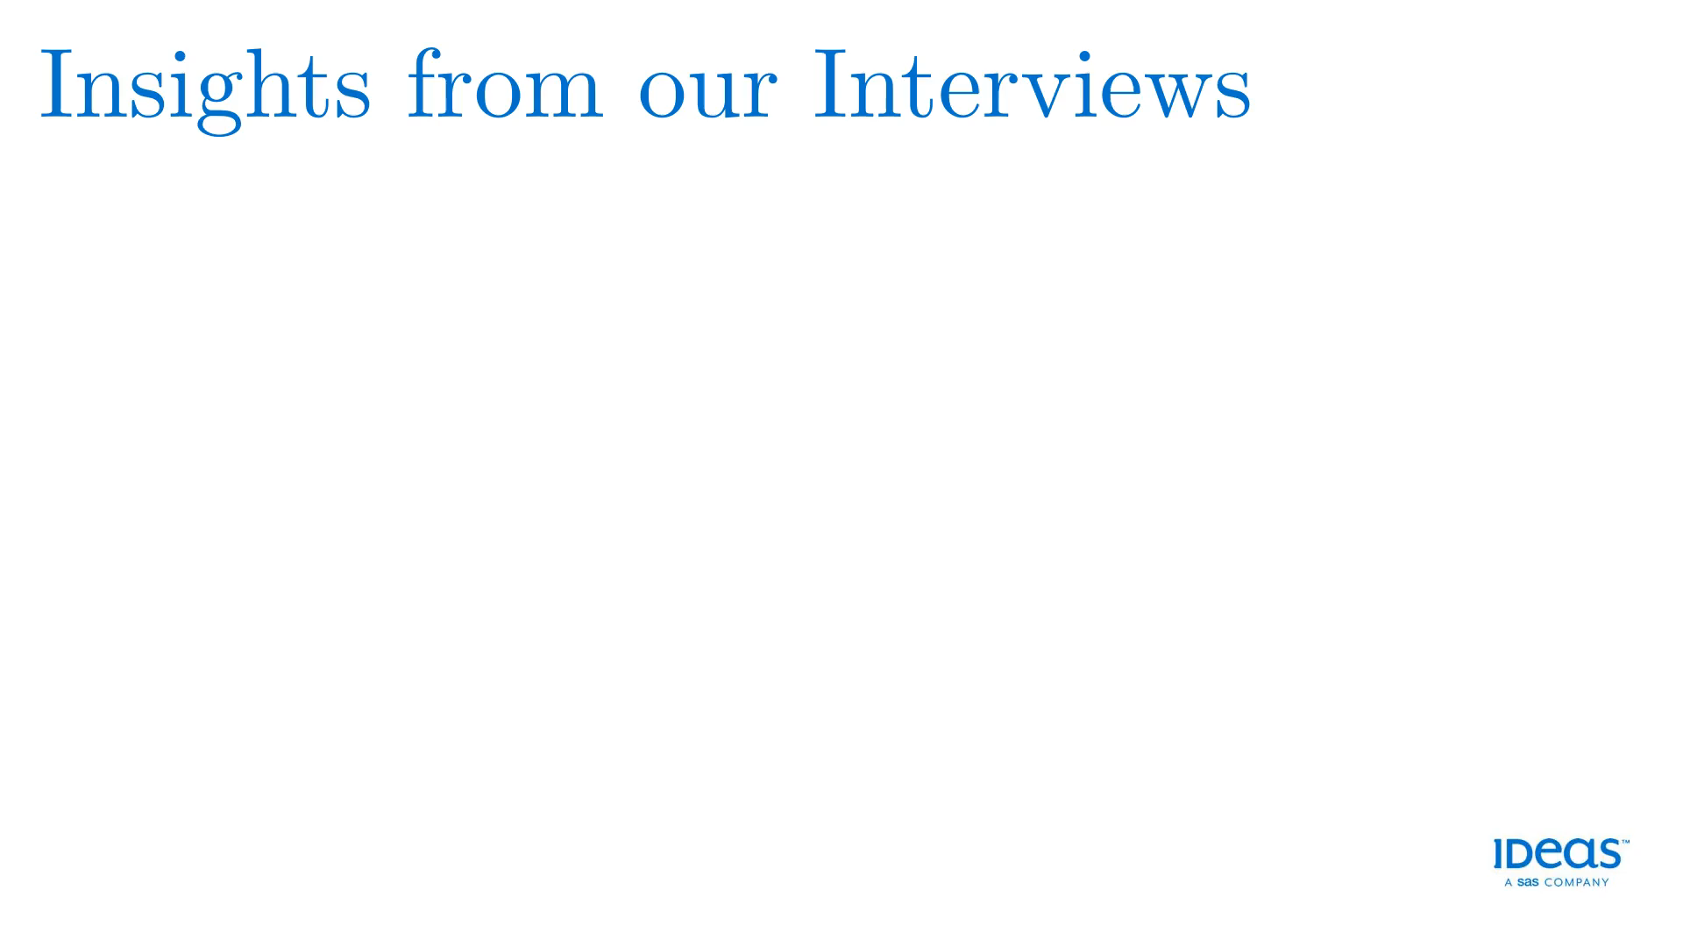
Insights from our Interviews
Shared Commitment
Our most Evident Value - Passion

Slide 18
Conclusion – What we learnt

